Slide 1

Principles of Program Design: Problem Solving with JavaScript
Chapter 7
Complex Conditions

Slide 2
Objectives
In this chapter, you learn to:
Express complex conditions with Boolean values and logical operators
Use truth tables, decision tables, and binary trees to specify conditions and their results
Use the correct syntax for logical operators in JavaScript
Explain how condition evaluation can be made more efficient with short-circuit evaluation

Slide 3
Objectives (cont’d.)
Specify the order for performing multiple condition evaluations
Determine whether complex conditions or nested conditions are most suitable

Slide 4
Describing Complex Conditions
Decision involving two or more conditions
  Describe the relationship between the conditions
Examples of complex conditions
  Dean’s list criteria
    12 credit hours and GPA > 3.5
  Movie theater discount
    Under 6 years old or over 65 years
  Employee bonus vacation
    Meeting sales quota and no absences in 3 months

Slide 5
Describing Complex Conditions (cont’d.)
Boolean variables
  Type holds only true or false values
  Declare variable in this way:
    Declare Boolean paymentIsOverdue
    Declare Boolean seniorCitizen
  Variable can be set to true or false in this way:
    paymentIsOverdue = True
    seniorCitizen = False
  True value is assumed without stating it
    If paymentIsOverdue Then
    lateFee = 4.00
    End If

Slide 6
Describing Complex Conditions (cont’d.)
Logical operators: And, Or, and Not
  Used to join conditions:
    When two or more conditions must be evaluated
Example: movie theater tickets
    Declare Boolean personHasMoney
    Declare Boolean showedID
    If personHasMoney And showedID Then
    ticketPrice = discountPrice
    Else
    ticketPrice = regularPrice
    End If

Slide 7
Describing Complex Conditions (cont’d.)
Or operator
  Used when only one condition must be true:
    For action to take place
Example: movie theater age discount
    If age < 2 Or age >=65 Then
    admissionPrice = 0
    Else
    admissionPrice = regularPrice
    End If

Slide 8
Describing Complex Conditions (cont’d.)
And and Or operators
  Binary logical operators
Not operator
  Unary logical operator
  Operates on a single condition
    Or single combined condition
  Example:
    If Not balance < 200 Then
    Display “Your account will continue to earn interest.”
    End If

Slide 9
Describing Complex Conditions (cont’d.)
Not Equals(!=) relational operator
  Use in place of Not
Often best to state condition in a positive way
  Avoid using Not or Not Equals
Not often used when negating a combined condition
Project: create an algorithm for the problem outlined on page 254

Slide 10
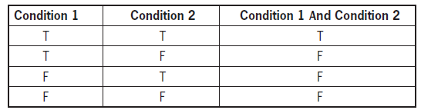
Logic Development Tools
Truth tables
  Tool for expressing results of condition combinations
Table 7-1 Truth table for the logical And operator

Slide 11
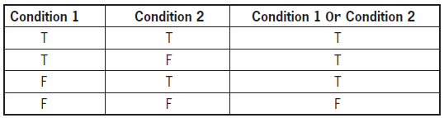

Logic Development Tools (cont’d.)
Table 7-2 Truth table for the logical Or operator
Table 7-3 Truth table for the logical Not operator

Slide 12
Logic Development Tools (cont’d.)
Some problems are more complex than combination of two conditions
  Multiple outcomes might be possible
Decision tables
  State all relevant conditions
  True and false combinations of these conditions
  Outcomes associated with each combination

Slide 13
Logic Development Tools (cont’d.)
Decision table structure
  Made up of rows and columns
  Number of combinations of conditions
    2 raised to the power of the number of conditions
  Top section has a row for each condition
    True or false
  Bottom section has a row for each outcome
    Performed or not performed
  Each column after first represents unique combination of condition results

Slide 14
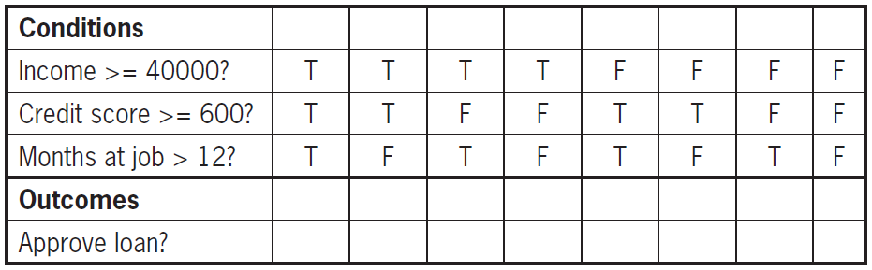
Logic Development Tools (cont’d.)
Mark each condition for the column with T or F
Mark X for each true outcome
Leave cell blank for each false outcome
Example: conditions for bank loan
Table 7-5 Decision table with T and F possibilities filled in

Slide 15
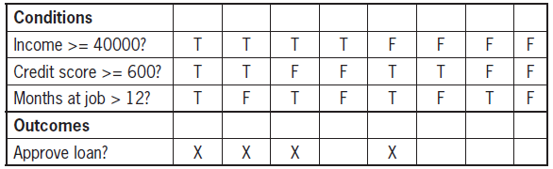
Logic Development Tools (cont’d.)
Table 7-6 Decision table with outcomes marked

Slide 16
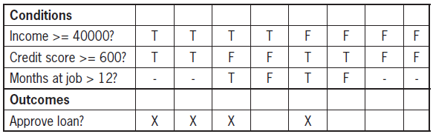
Logic Development Tools (cont’d.)
Can have irrelevant conditions
  Mark with a dash
Table 7-7 Decision table with irrelevant conditions marked

Slide 17
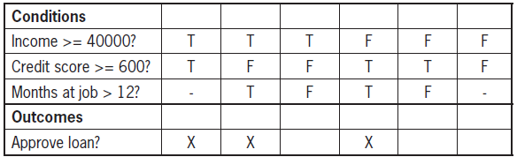
Logic Development Tools (cont’d.)
Combine irrelevant condition columns into one
Table 7-8 Decision table with irrelevant condition columns merged

Slide 18
Logic Development Tools (cont’d.)
Binary trees
  Trace all combinations
  Start with one condition
    Splits into true and false paths
    Paths lead to next condition
  Irrelevant conditions don’t split into true and false paths
  Flowchart shapes often used to draw

Slide 19
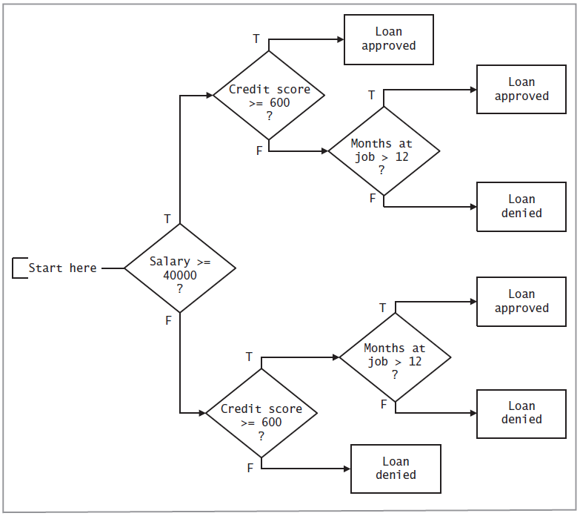
Figure 7-1 A binary tree showing the logic of the bank loan decision process

Slide 20
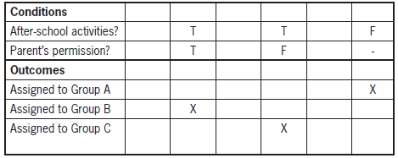
Logic Development Tools (cont’d.)
Project: Create binary tree for field trip problem on pages 260-261
Table 7-9 Decision table for a field trip after merging irrelevant conditions

Slide 21
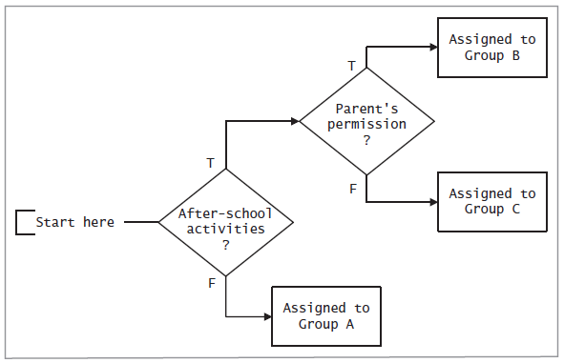
Logic Development Tools (cont’d.)
Project solution:
Figure 7-2 A binary tree showing the logic of the field trip selection process

Slide 22
Describing Complex Conditions in JavaScript
JavaScript logical operators
  And operator is &&
  Or operator is ||
  Not operator is !
Conditions enclosed in parentheses
Complex condition JavaScript example:
if (condition1 logicalOperator condition2)
Scope enclosed in braces

Slide 23


Describing Complex Conditions in JavaScript (cont’d.)
Complex condition JavaScript example with scope:
JavaScript example using Not operator:

Slide 24
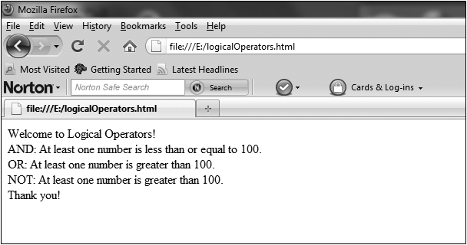
Describing Complex Conditions in JavaScript (cont’d.)
Complete Program 7-1 on pages 264-265
  Then convert to JavaScript
Figure 7-3 The logicalOperators.html program in a Web browser

Slide 25
Working with Complex Conditions
Short-circuit evaluation
  Used with two conditions joined by And
  If first is false:
    No need to evaluate the second one
  Speeds processing
  Used with two conditions joined by Or
    If first one is true:
      The second one is not evaluated
Arrange order of conditions:
  Such that first evaluation is more likely to determine outcome

Slide 26
Working with Complex Conditions (cont’d.)
Example: pizza customer discount
  Discount for 6 or more orders placed in past month
  And order total is $20 or more
  Historical records:
    10% of customers place 6 or more orders
    40% of orders total $20 or more
Solution: place condition about number of orders first
  Results in all but 10% of evaluations false
  Eliminates need to evaluate second condition in most cases

Slide 27
Working with Complex Conditions (cont’d.)
Logical operator precedence: use parentheses
  Two or more conditions:
    Joined by one or more logical operators
  If operators are identical
    Order of conditions doesn’t affect result
  If operators are different
    Potential for error increases
Order of precedence
  JavaScript: And takes precedence over Or
  May differ by programming language

Slide 28

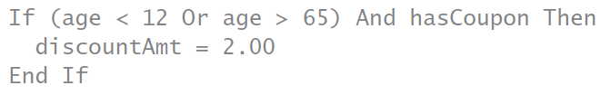
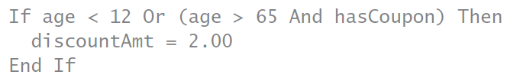
Working with Complex Conditions (cont’d.)
Example:
Use parentheses to eliminate confusion
Parentheses specify your intended order

Slide 29
Working with Complex Conditions (cont’d.)
Exercises: complete problems on page 269
Complex versus nested conditions
  Complex condition used when:
    One action performed with combined condition is true
    A different action performed if false
  Nested condition used when:
    Conditions lead to different outcomes

Slide 30
Working with Complex Conditions (cont’d.)
Example: customer discount
  Preferred customers have status P
  Regular customers have status R
  Preferred customers get a 20% discount on orders of $50 or more and 10% discount on other orders
  Regular customers get a 10% discount on orders of $50 or more and no discount on other orders

Slide 31
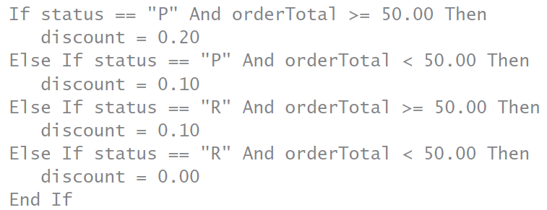
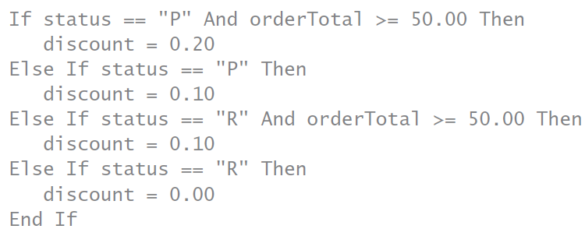
Working with Complex Conditions (cont’d.)
Example solution using complex condition:
Or simplified:

Slide 32
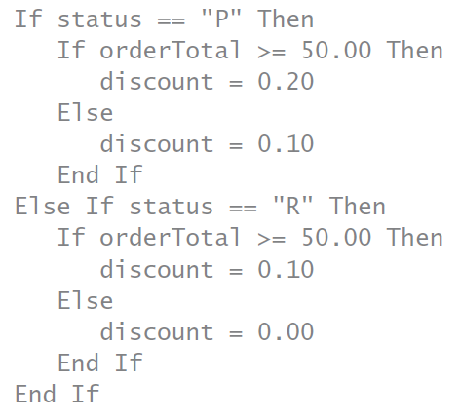
Working with Complex Conditions (cont’d.)
Example solution using nested condition
  Gives clearest logic
  Fewest comparisons

Slide 33
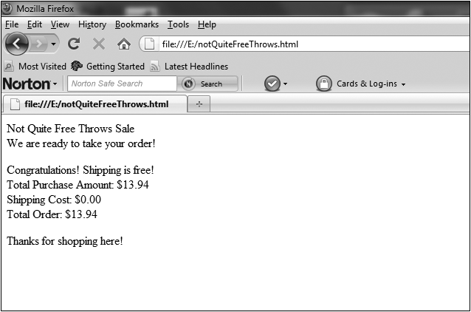
Working with Complex Conditions (cont’d.)
Complete Programmer’s Workshop on pages 271-273
  Then convert to JavaScript
Figure 7-4 The notQuiteFreeThrows.html program in a Web browser

Slide 34
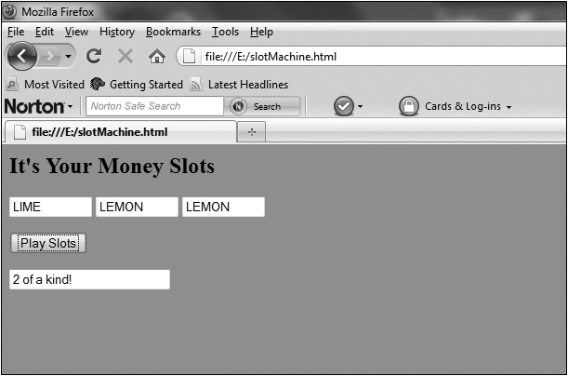
Working with Complex Conditions (cont’d.)
Complete Object Lesson on pages 274-278
Figure 7-5 The slotMachine.html program in a Web browser

Slide 35
Summary
Boolean variables can be used to represent evaluating a condition
Logical operators And, Or, and Not can be used to combine conditions
And: true if both conditions are true
Or: true if at least one condition is true
Not: negates a condition or a combined condition
Tools for developing logic
  Truth table, decision table, binary tree

Slide 36
Summary (cont’d.)
JavaScript symbols for logical operators: &&, ||, !
Short-circuit evaluation eliminates evaluating a condition if outcome is already determined
Using multiple logical operators
  Be aware of order of precedence
  Use parentheses to override default precedence
Complex conditions used for one outcome for a combined condition
Nested conditions used when any condition has different outcomes for true and false evaluations

